Slide 1

TEAM CLOUD CHRONICLES
MICROSOFT AZURE VIRTUAL HACKATHON 2021
Athira Krishnakumar Nair, Prashant Islur, Ravi Singh, Dhruv Sharma
Team From New Zealand

Slide 2
Problem statement
Small businesses and start-ups are important for fostering local economies, reducing unemployment, and generating vibrant and supportive community.
US Small Business Administration (SBA) supports small businesses and start ups through a loan guarantee program. This program supports banks to grant loans to small businesses by reducing the risk of the banks to lose loan money as SBA guarantees the portion of the loan if the business default on repayment.
As SBA guarantees only a portion of the loan, banks still incur losses and hence face difficulty in decision making to whether the loan should be approved or not.
There has been many barriers in the process of acquiring the credit. Banks and SBA becomes more risk averse during the period of financial crash. Such challenges were echoed once more in 2020 with the outbreak of COVID-19 virus, impacting the small businesses on an international scale.
In banking and financial institution, the role of a loan officer to engage with small business and document company’s context and nature of the loan requirement is quite daunting and time consuming.
Previous researches have showed that a stand alone credit scoring model can sometime act as a weak predictors of loan default thus resulting in a high cost per loan.

Slide 3
Objective
There has been a lot of research and analysis on loan default situations but our main goal was to leverage the use of Microsoft Azure Machine learning (ML) and Artificial Intelligence (AI) platform and utilise our data science capabilities to build a predictive model that can identify high risk customers.
We have created an end-to-end solution providing the customers and bankers an easy to use platform. For that purpose, we had made use of Power Apps.
We have a built ML model to predict the loan defaulters. Using this approach we are trying to minimise risk of the bank incurring losses from defaulted loans.
Our focus also includes exploring the opportunities of integrating Microsoft Azure Cognitive Services to provide AI solutions to assist with loan document application, determine client’s affordability and predict credit risk.
To achieve that, we have made use of textual data to identify the market sentiment of the company.
Our plan is to combine unstructured data with the structured data to create a framework that can speed up the interpretation process by extracting an automated risk score that we can demonstrate is predictive.
Although, due to restricted timeframe we have made use of publicly available financial news dataset which is no where related to the loan default data.
Hence, the news data and the structured data integration was out of our scope. We managed to build a prototype using dummy data. So the accuracy of the model is not good with the data we are using but the solution will be something we can extend and improvise with real-time datasets.

Slide 4
team approach to build azure ML solution
Research on data that aligns with the problem statements.
Deployed the ML model and used Power Automate to connect to Power Apps to build an interactive platform.
Finalised the raw data that best aligns with the bank problem due to Covid-19 situation.
End to End Solution thought process
Used AutoML and Designer in Microsoft Azure to build the best ML models.
Studied each and every column of the data. Data Pre-processing was carried out.
Power BI to perform exploratory analysis and to choose the variables that will best support the prediction.

Slide 5





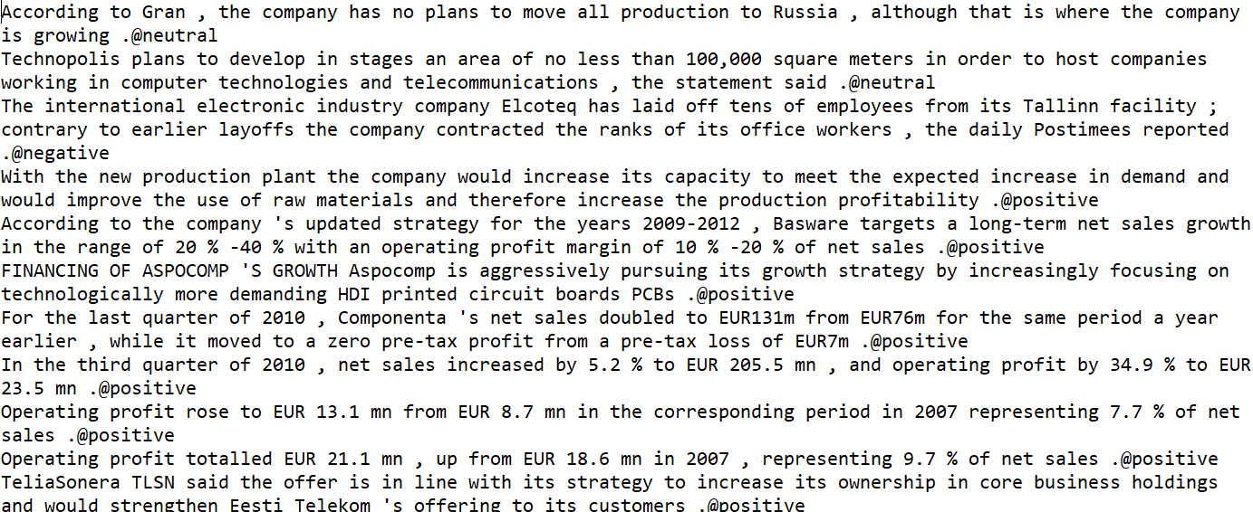



Dataset overview
Dataset 1 : Structured SBA Loan Data
Dataset 2 : Unstructured Financial News Data
1900 - 2014
Accounted for variation due to the Great Recession (December 2007 to June 2009)
Gross Disbursement Amount
Charged off Principal Amount
SBA Gross Approval Amount
Balance Gross Amount
Whether the business is new or existing one?
Term of the loan
Whether the company has gone through LowDoc Program?
Whether the company lies in the revolving credit line?
No. of Job Created and Retained
No. of employees in the company
Whether business is a franchise or self-owned?
50 US States
City
Zip Code
Charged off
20 different industries loan records
Bank State
Bank Name
Loan Digit Number
Paid in Full

Slide 6
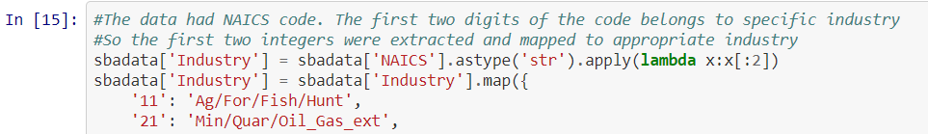
Data Preparation using Python (Jupyter Notebook)
SBA dataset
Dropped the rows with Null values as the data is quite large
Remove Nulls
Converted other columns to correct datatype
Changing datatype from object to int, float, date time etc
NAICS code to industry mapping
First 2 digits from the NAICS code extracted and mapped to specific industry as per SBA industry code structure.
Included additional variables such as recession, real estate, and converted most of the variables to a binary structure.
To identify data corresponding to the recession period
Include real estate where Term >= 240 months
Cleaned Dataset
Final clean dataset passed to Microsoft Azure ML studio

Slide 7
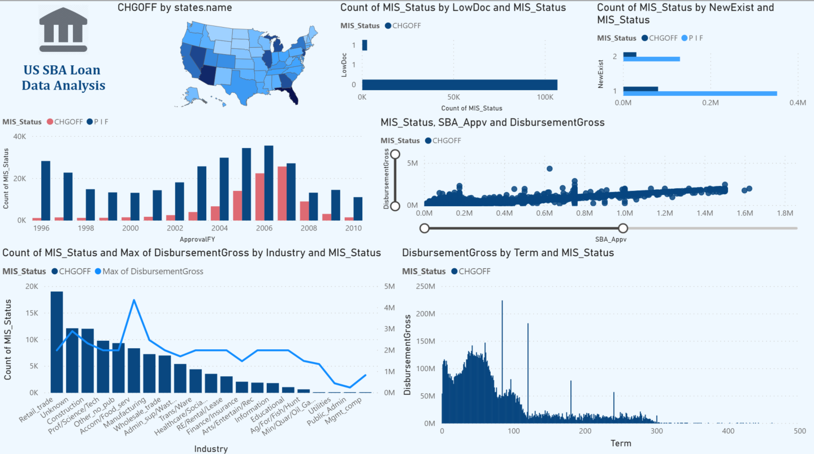
Exploratory Analysis using Power bi
1
2
3
Higher default rate has been observed in Florida, Georgia, Arizona, Nevada, Illinois, Michigan, and California.
Relatively low default rate has been observed if the customer has gone through Lowdoc program.
Comparatively high default rate has been observed if the loan has been approved for a new business. But at the same time high proportion of customers have repaid their loan who belongs to a new business. Thus, background of the business needs to be studied.
High default rate was evident due to Great Recession period (2007-2009).
A relatively positive correlation can be observed between the loan amount disbursed and SBA Approval amount. This tells us that higher the amount of loan, higher proportion of amount is guaranteed by SBA. Higher default rate has been observed where the SBA approved amount were less than or equal to 1.5M.
Higher default rate has been observed in Retail and Trade Industry followed by construction, Science and Tech industry.
High default rate has been observed when the business took loan for less than 100-150 months.
4
5
6
7
 | https://app.powerbi.com/view?r=eyJrIjoiYzY5YzdiNDItODliNC00NjZjLWJmODMtZWFkNWYzMWNmNzY5IiwidCI6ImM2NTk0MjIxLWY1N2ItNDFiNS1hMDU2LWJiOWQ0NzdiZGYwYSJ9

Slide 8
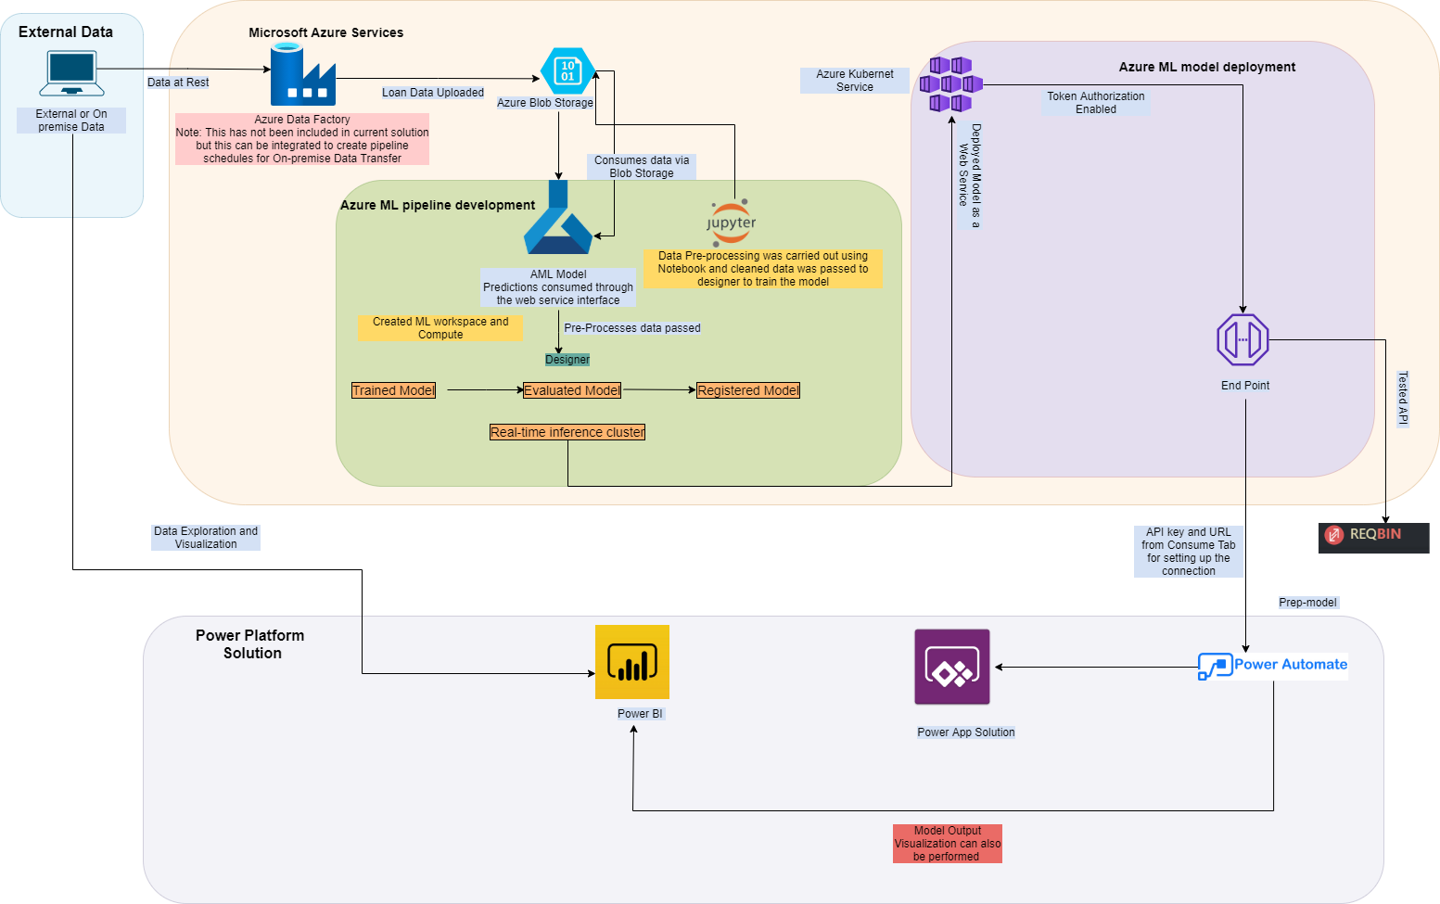
Our Microsoft Azure Architecture solution for loan prediction
The solution walks through the end-to-end process of how to develop predictive analytics using a set of simulated loan history data to predict loan charge off risk.
The solution template also includes a set of python scripts used to perform data pre-processing.
Exploratory analysis have been performed with pre-processed data using Power BI.
The solution also includes scripts to deploy the model as a webservice.
The model is consumed to Power Apps using Power Automate.

Slide 9
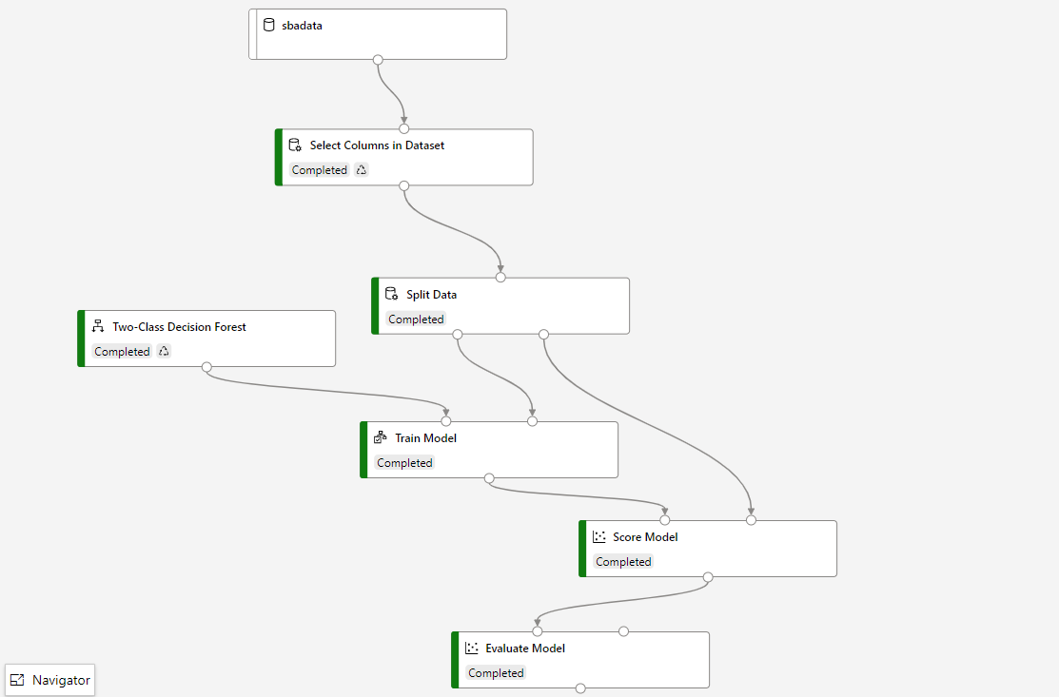
Training Designer Model
Data cleaning was carried out using Jupyter notebook and cleaned data was passed to this ML pipeline
Selected relevant columns from the Training dataset.
Two-class decision forest model was used.
Split the data into 80% training and 20% testing datasets.
Model trained using the training dataset.
Model scoring carried out using the testing dataset
Model metrics calculated like F1-score, accuracy, precision, and recall

Slide 10
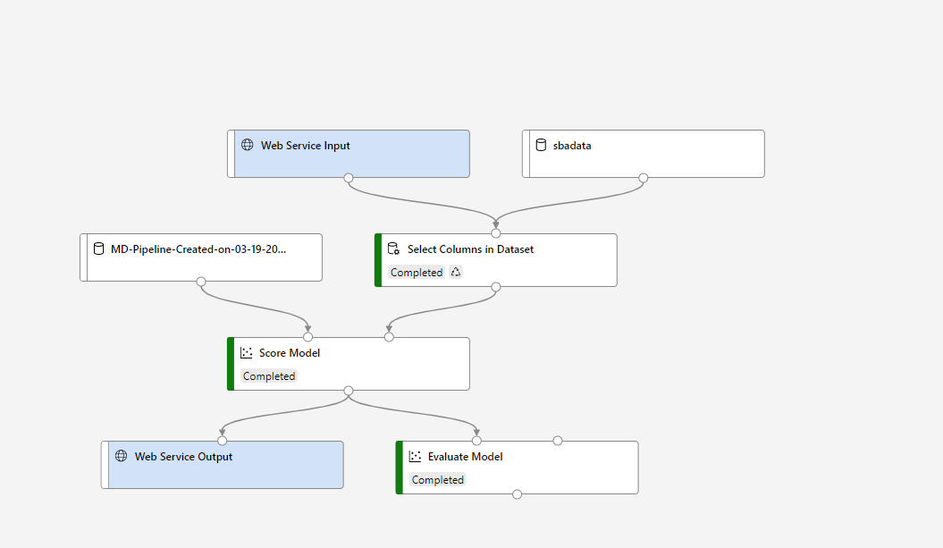
Deploying Designer Model
Deploying model as a web service
To deploy our pipeline, we converted the training pipeline into a real-time inference pipeline.
This removed training modules and added web service inputs and outputs to handle requests.
The webservice inputs and outputs are the modules from where the user data enters the pipeline and returns.

Slide 11
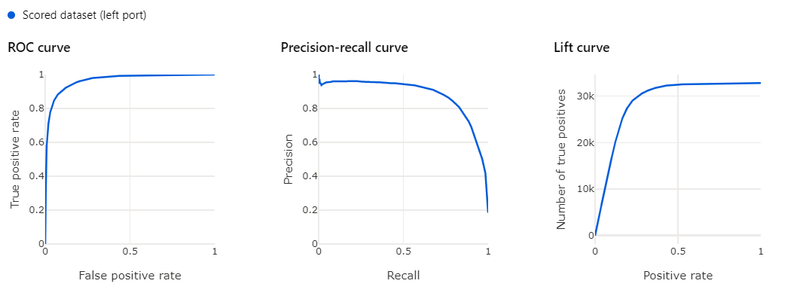
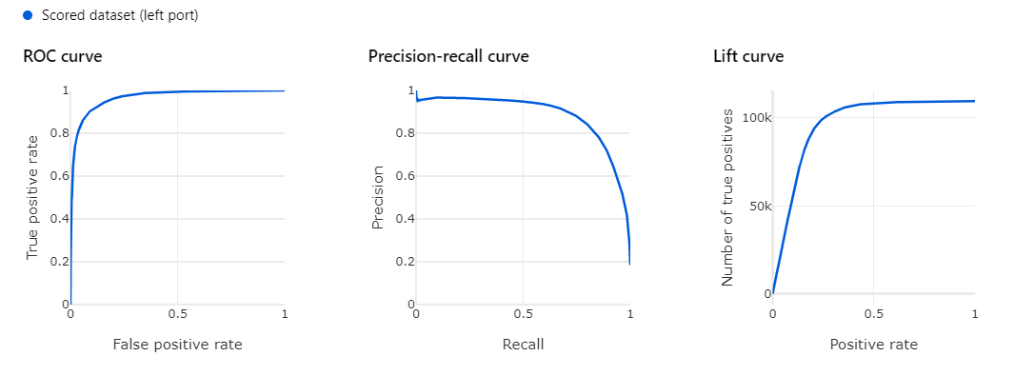
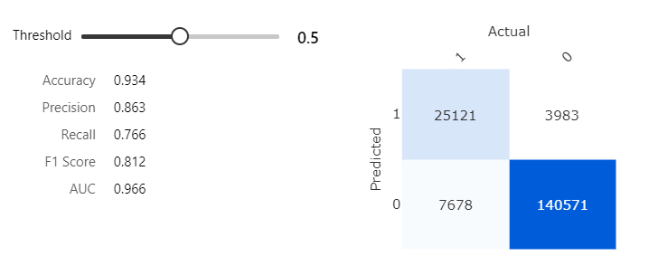
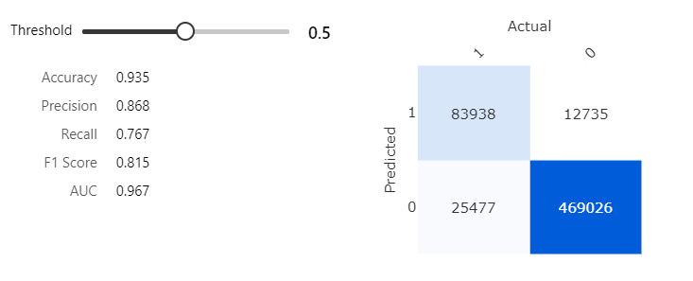
Machine Learning - Designer Model Output
Training Data Model Output
Testing Data Model Output
ROC curves – trade off between true-positive rate and false positive rate for a predictive model using different probability thresholds. We have used 0.5 as the probability threshold. From the output we can see that model has skill with an AUC score of 0.96 which means there is 96.6% chance that the model will be able to distinguish between defaulted and non-defaulted customer.
Precision-Recall curves – precision value of 0.863 concludes that 86.3% of the results are relevant. Recall value of 0.766 concludes that 76.6% of the total relevant results are correctly classified by the model.

Slide 12
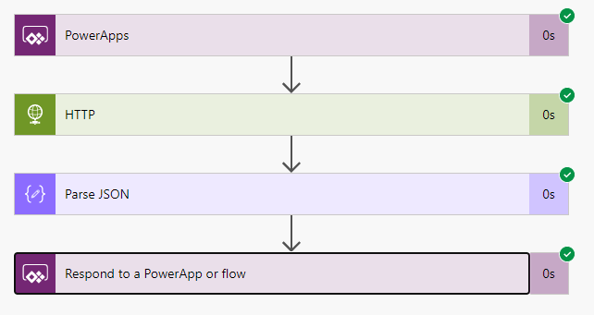
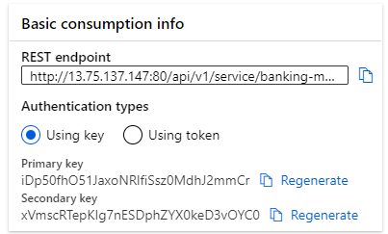
USER Interface – Power aPP Integration
Power Automate flow to connect ML model to Power Apps
REST API Endpoint used to consume model
Once the pipeline is developed in designer, we made a real point inferencing endpoint to publish and then deploy it using Azure Kubernetes Cluster.
The endpoint is then integrated to power app using power automate flow using an https connection.
A banker can then feed in the customer details from the power app, prediction for which is requested from the endpoint service in real time via the power automate https connection.
The JSON Request is passed to the API endpoint, the prediction output of which is then parsed again in JSON to feed it back to the Power App. All this in for just a click of a button.

Slide 13
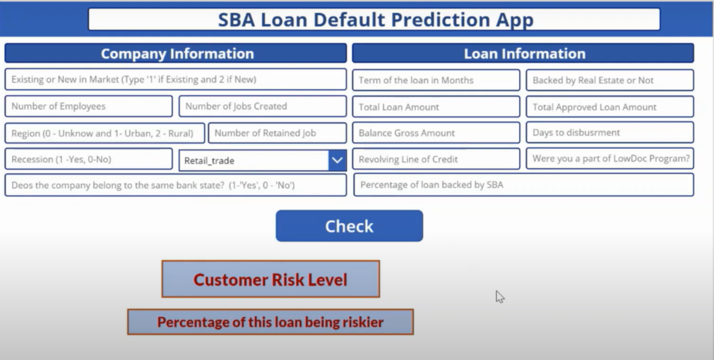
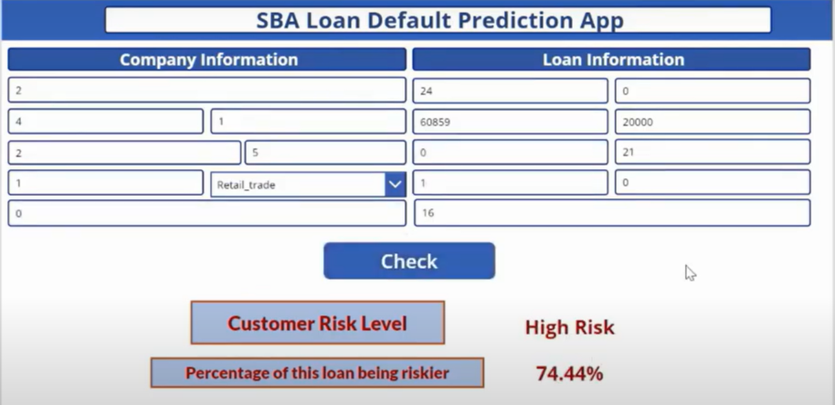
Power aPP solution
APP Structure
App Prediction

Slide 14
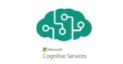
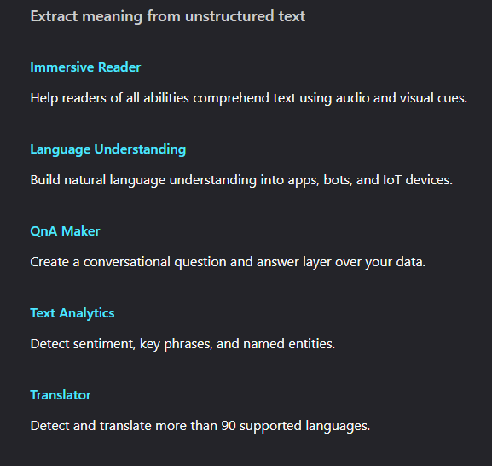
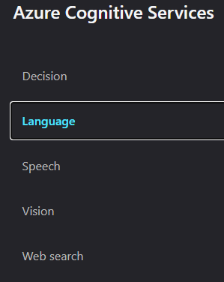
What is Azure Cognitive Services
Cognitive Services brings AI within reach of every developer—without requiring machine-learning expertise. All it takes is an API call to embed the ability to see, hear, speak, search, understand, and accelerate decision-making into your apps. Enable developers of all skill levels to easily add AI capabilities to their apps.

Slide 15
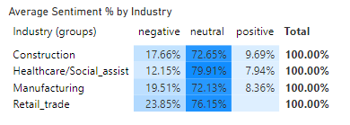
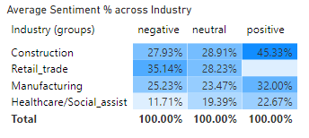
Azure cognitive services – Text Analytics API USE CASE
We intend to use Industry specific news to merge market sentiments with our SBA loan banking prediction app. This is an enrichment step to our solution.
An aggregated average sentiment for an industry is then calculated which could then be used by Banks/Venture Capitalists in understanding which industry loans to approve/ or where to invest/divest money.
We track these metrics by month and year as and when the unstructured news dataset grows in size. The use of Azure Cognitive Services API is cost efficient to find out Sentiments and Key phrases from the text data.
A Power BI Dashboard is developed, published to Power BI Service and specific tiles are then pinned to Power Apps. We could not link Power App to Power BI in our case because we did not have the Power BI Service license.
Example - Data suggests that for the time period, Retail industry has a higher negative sentiment compared to other industries whereas Construction has a higher positive sentiment vis a vis the others.

Slide 16
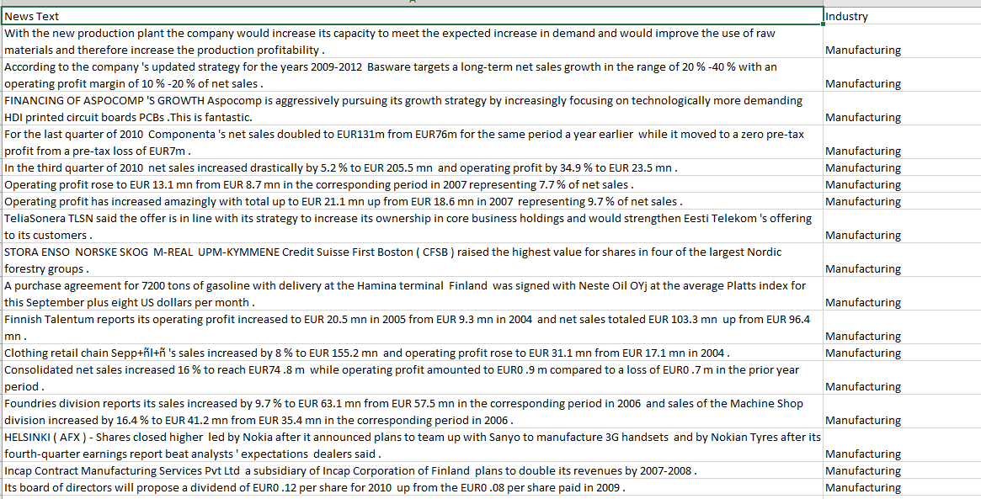
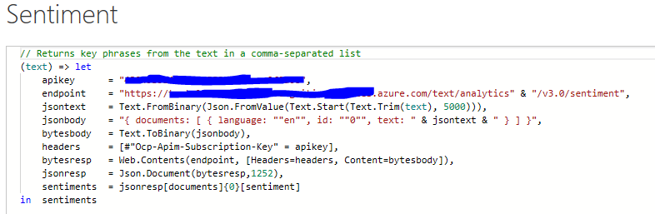
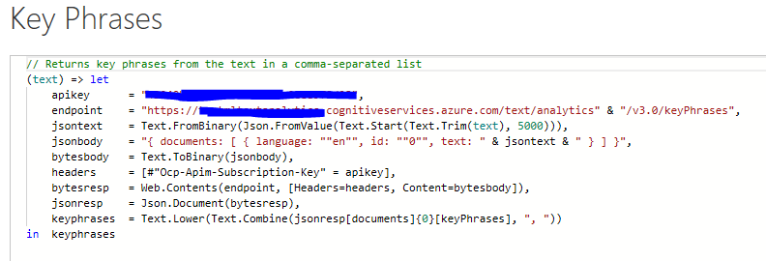
Azure cognitive services – Text Analytics API
An AI service that uncovers insights such as sentiment, entities, relations and key phrases in unstructured text.

Slide 17
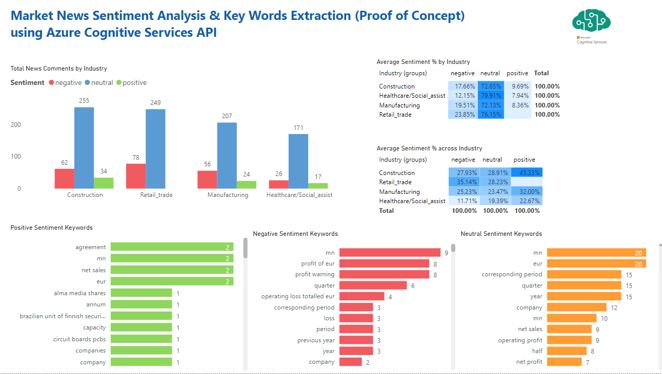
Azure cognitive services – Integration to PowerBI

Slide 18
Discussion & running prototype
The running prototype can be found here: https://www.youtube.com/watch?v=G58ybK9OuFQ
We propose that the traditional credit scoring model can add more value using the textual or unstructured data collected by the portfolio officers or scrapping finance market news along with the customer credit history dataset.
Our proposed model still has a reasonable amount of false negative values which can be quite devastating to the lending companies. So, a more detailed study focusing on the false negatives will be a great approach.
We advise adding an extra layer of textual information to the structured dataset and the use of Microsoft Azure AI and ML products can be very useful to suggest a single risk prediction score and a corresponding accept/reject decision.
This approach will speed up the interpretation process as well as improve both the lender’s structured data and text collection practices.

Slide 19
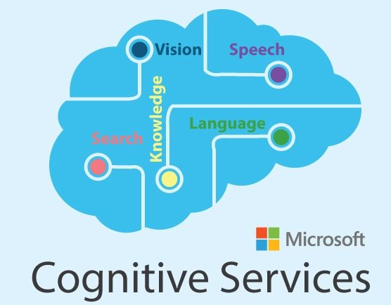








potential market to use the solution
Using Azure Cognitive services – Anomaly detector we can get early warning signals by identifying the potential entities that are exposes to high risk of default before even it occurs.
Using Azure Cognitive services – Microsoft Azure AI Text Analytics:
To analyze the textual data using Natural language processing to build translational apps or virtual assistant on smart phone that can help even the not so techno savvy people.
To capture the written media from social media posts to financial news that can be used as a potentially good parameters for stronger credit analysis.
Artificial Intelligence (AI) can widely touch on areas like fraud detection, model validation, stress testing, and credit scoring.
Some of the limitations to the model are as follows:
Most of the AI algorithms are considered as black box which can make the governance framework for these applications relatively immature.
To overcome the issue off poor governance framework we need relatively high-quality data to keep the AI running properly.
Solution Use Case
Leveraging the Azure platform for ML, AI and AA
Financial Institutions, Regulators and Venture Capitalists
Determining industry credit worthiness
Detection of Fraud patterns
Anti-laundering Money
Financial lending to small business enterprise
Loan Banking providers
Streamlining the loan application process.
Identifying the riskier applicants
Lower operational cost
Customer Segmentation
Increase chances of cross selling
Help increase customer lifetime value
Model Development and Deployment
Consumers
Customers can fill in their own details:
To find out how likely they are to be offered a loan
To find out like to like customers
Personalise repayment schedule to increase the chance of future loan approvals.
ML Pipeline Orchestration and Storage

Slide 20




KNOW the Team Behind This
Ravi Kumar Singh
Information Analyst & Machine Learning Engineer
Pegasus Healthcare Limited, NZ
6+ Years in Analytics, Machine Learning, AI Experience
Masters of Applied Data Science - University of Canterbury, NZ
Chess, Football Enthusiast, Basketball
Dhruv Sharma
BI & Data Science Specialist
Farmlands Cooperative Society Limited NZ
Ex Deloitte | 8+ Years Analytics Experience
Masters of Applied Data Science - University of Canterbury, NZ
Post Grad Dip in Business Management - Symbiosis International University
Problem Solver, Cricket Enthusiast
Athira Krishnakumar Nair
Lead Data Scientist at Pyper Vision | Microsoft Data Analyst Associate Certified | SAS Predictive Modelling Certified
Leads NZ Data Science and Machine Learning community with 60+ data scientist across industries.
Masters of Applied Data Science from University of Canterbury, New Zealand
Masters in Statistics from Narsee Monjee Institute of Management Studies
Chess Player, Dancer, and Painter
Prashant Islur
Data Analytics & Cloud Specialist
15+ Years IT managed services Experience
Masters of Applied Data Science - University of Canterbury, NZ
Masters in Project Management - Sikkim Manipal University
B.E in Electronics & Telecommunication , Mumbai University
Team Leader, Mentor, Travel Enthusiast

